Slide 1
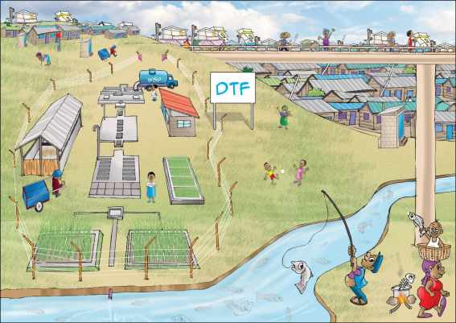
UBSUP
Introduction to the
Decentralised Treatment Facility (DTF)

Slide 2
THE CONCEPT
DTF
Sanigo
Exhauster
Exhauster
UDDT
Pit latrines
Septic tanks
Low Income Area

Slide 3
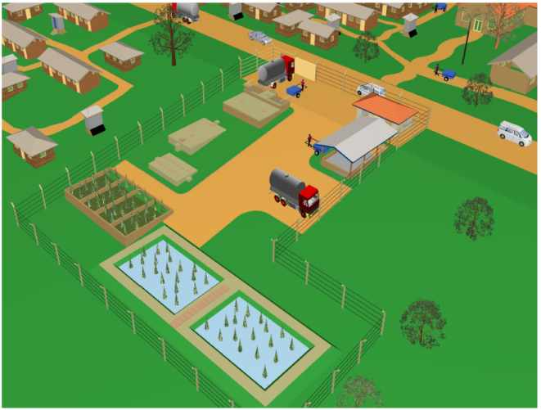
THE DTF MODULES
Receiving Bay / Balancing tank (RBBT)
1
3
Settler (ST)
Anaerobic Baffled Reactor (ABR)
7
2
Vertical Flow Constructed Wetland (VFCW)
6
4
Sludge Drying Reed Beds (SDRB)
5
Composting Area (CA)
Operator Store (OS)

Slide 4
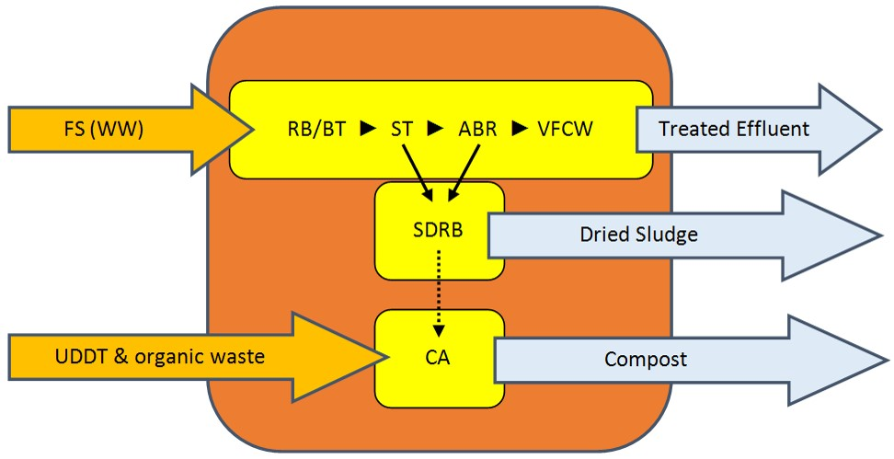
THE TREATMENT
NO CHEMICALS !!
→ Mechanical and biological treatment
NO ELECTRICITY !!
→ DTF runs by gravity

Slide 5
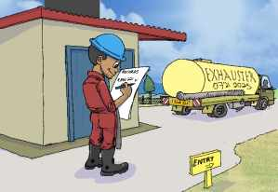
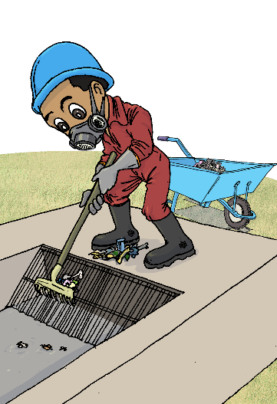
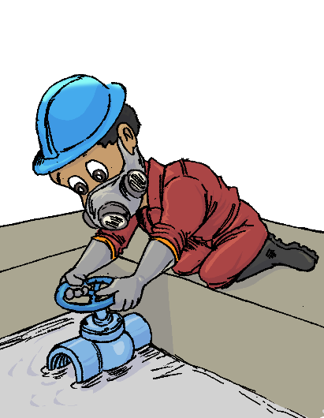
IN DETAILS
1
Operator Store
Operator’s office
Entrance registration desk
Storage room for equipment
2
Receiving Bay / Balancing Tank
Screening of the coarse material
Storage of the effluent
Flow control to provide constant inflow to the DTF

Slide 6
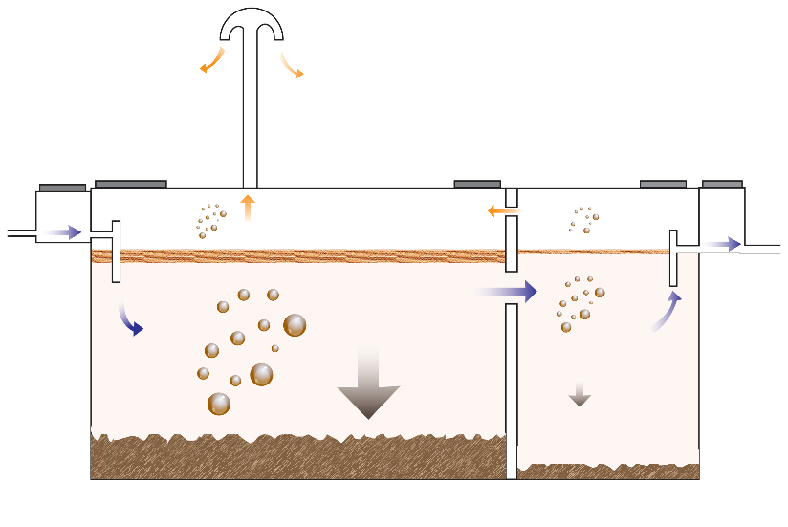
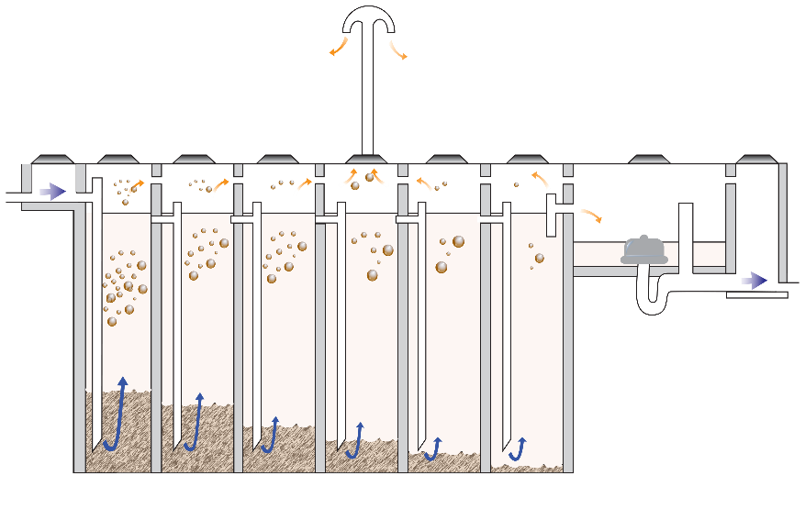
IN DETAILS
3
Settler
2 consecutive chambers separated with a baffle wall
Sedimentation of settable solid
Flotation of fat and oil
4
Anaerobic Baffled Reactor
2 rows of 6 consecutive chambers with down pipes → anaerobic treatment through the settled sludge
1 siphon chamber → to release intermittent flow

Slide 7
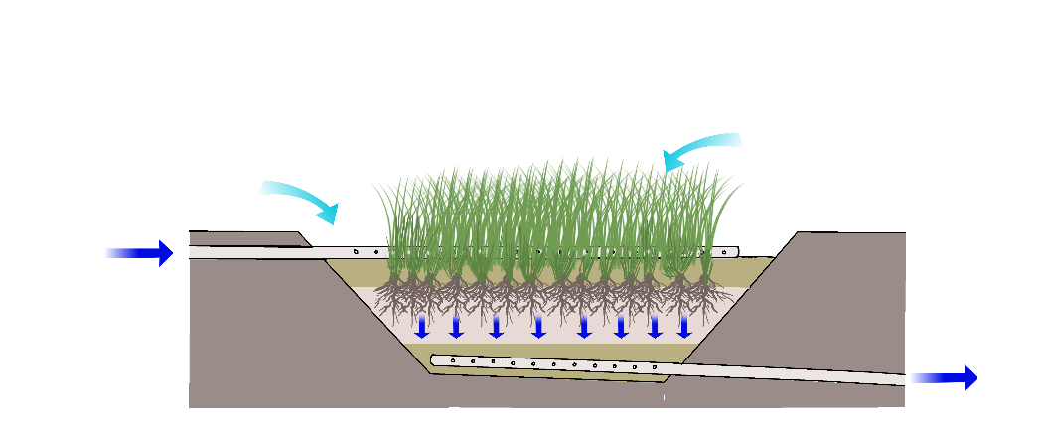
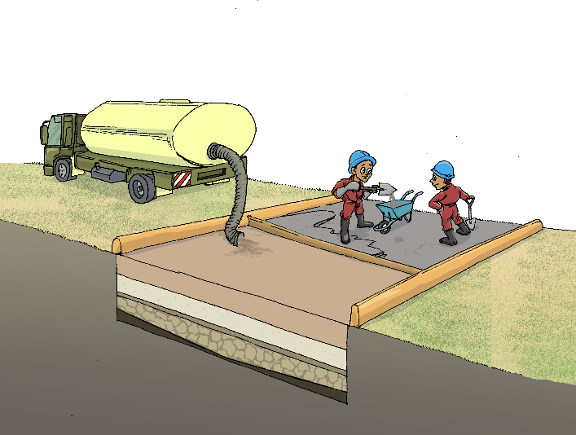
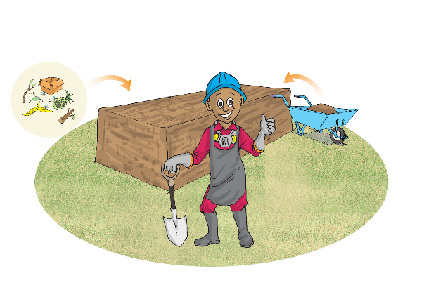
IN DETAILS
5
Vertical Flow Constructed Wetland
2 basins filled with successive gravel and sand layers planted with aquatic plants
Perforated pipes on top (to feed) and at the bottom (to receive)
FiItration, and aerobic treatment
6
Sludge Drying Beds
2 to 4 non planted beds filled with successive gravel and sand layers
Filtration and evaporation
7
Composting Area
Composting shed
Mix dry sludge and organic waste to produce compost

